Slide 1
"Navigating the Pulse of Jakarta": Uncovering Hidden Patterns Behind Millions of Transjakarta Transactions
Irfan Maulana
Data Analyst – Final Project Ms. Excel DQLab

Slide 2
Business Overview Transjakarta
The Pulse of Mobility: Transjakarta is not just a mode of transportation; it is the pulse of Jakarta citizens' mobility with millions of daily transactions.
World's Longest BRT: Transjakarta is not merely a city bus, but a Bus Rapid Transit (BRT) system with the longest track in the world (over 250 km).
Integration Ecosystem (JakLingko): Currently, Transjakarta has transformed into a giant ecosystem under the umbrella of JakLingko, integrating Big Buses (BRT), Non-BRT Buses, and micro-transport (Mikrotrans/Angkot) with a single centralized cashless payment system.
Massive Volume: Serving millions of customers daily, generating transaction data that is extremely large (Big Data) and complex.

Slide 3
Storytelling Dataset Transjakarta
Every time a card is tapped at the gate (Tap-In), it is not just a ticket payment. It is a digital footprint telling the story of Jakarta citizens' lives.
This dataset records passenger activity for 1 full month, covering:
Who are they? (Demographic profile & payment preferences).
When do they move? (Peak hour patterns and holidays).
Where do they go? (Favorite routes and crowd centers).
What is the economic value? (Revenue contribution per hour)

Slide 4

Strategic Missions
The objectives of this analysis are summarized in 3 Strategic Pillars:
Revenue Optimization: Identifying key revenue sources and validating the Pareto Law (80/20) in operations.
Operational Excellence: Adjusting fleet schedules based on accurate Peak Hour data (not just intuition).
Customer Centricity: Understanding passenger profiles (Generation & Bank) for more personalized partnership and promotion strategies.

Slide 5
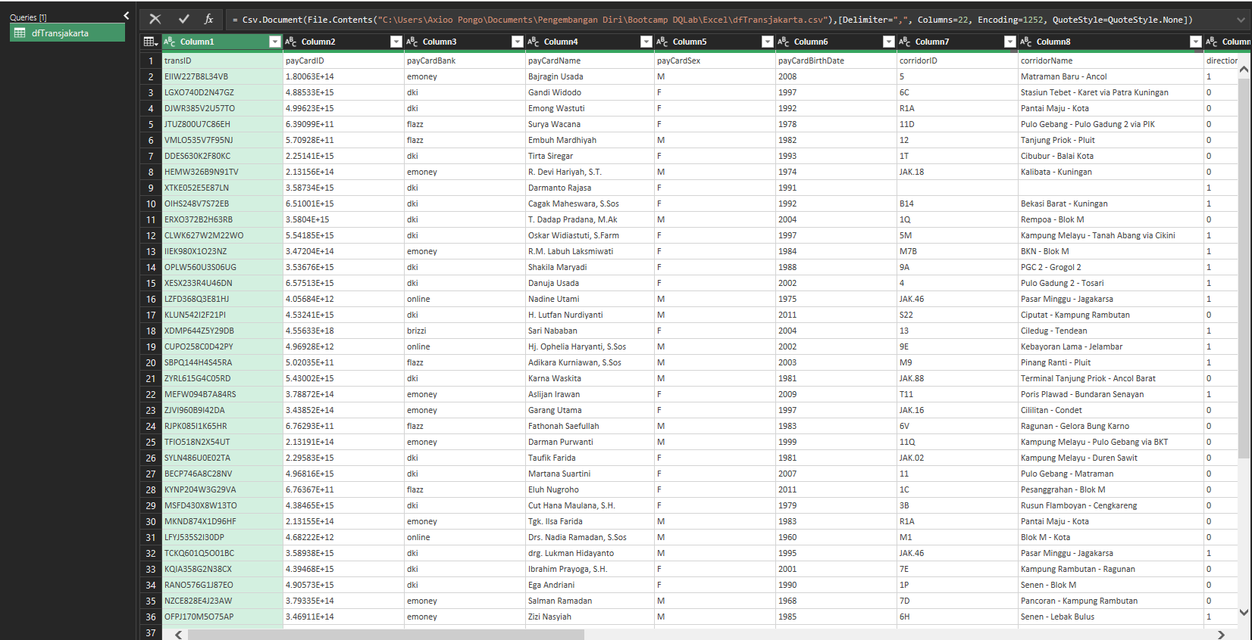
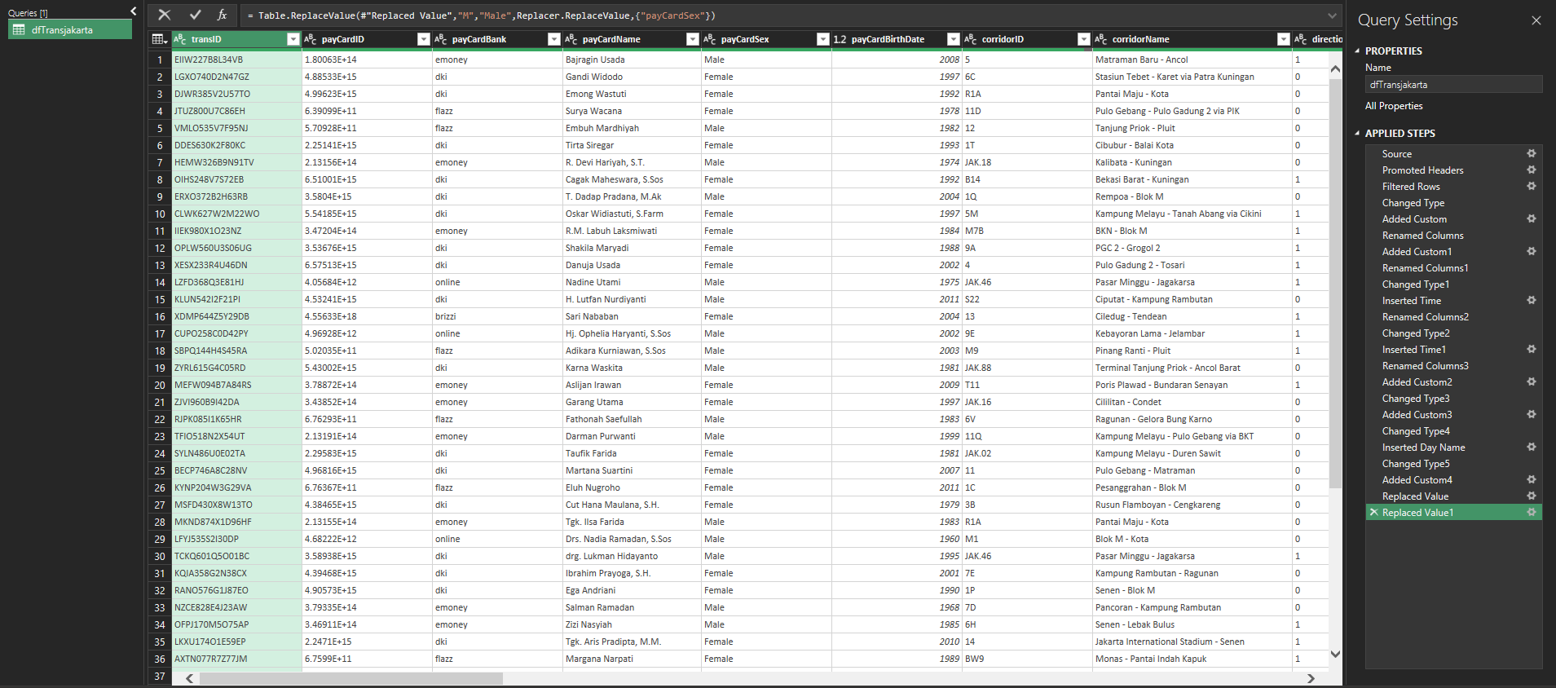
Data Preparation
Before analysis, Data Cleaning and Data Processing were performed using Power Query to handle duplicates, input errors, and missing values to obtain actionable insights
Data Cleaning
Cleaning data from duplicate, miss imputation, or missing value.
Data Proses di Power Query
Process data to get insight

Slide 6
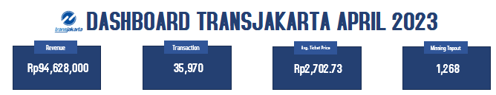
Transjakarta Overview (April 2023)
Total Revenue: Rp94,628,000.
Total Transactions: 35,970 passengers.
Average Ticket Price: Rp2,702.73.
Missing Tap-out: 1,268 (approx. 3.53% of passengers failed to tap out).

Slide 7
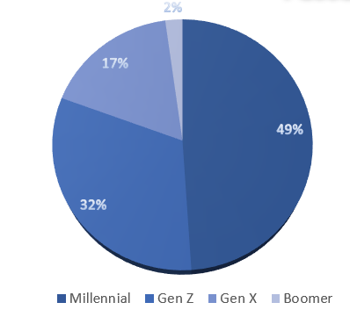
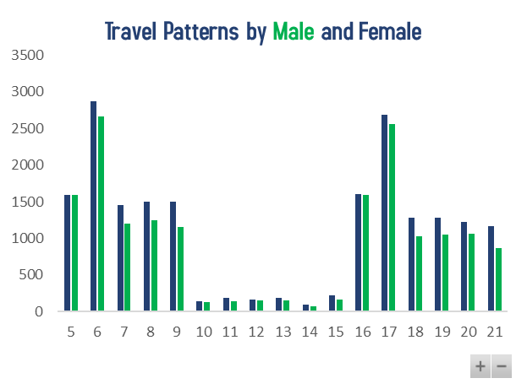
Passenger Demographics
Passengers are dominated by Millennials (49%), followed by Gen Z (32%). These groups are the working class requiring high mobility at affordable prices.
Interestingly, Transjakarta passengers are predominantly Female compared to Male.
Insight:
Since 80% of passengers are Digital Natives, communication strategies (complaints, route info) must be digital-first (App/Social Media). Do not spend budget on printed brochures.
Since the majority are women, "Anti-Sexual Harassment" programs and CCTV/Officers on buses are key to customer retention. If women feel unsafe, Transjakarta risks losing its largest customer base.

Slide 8
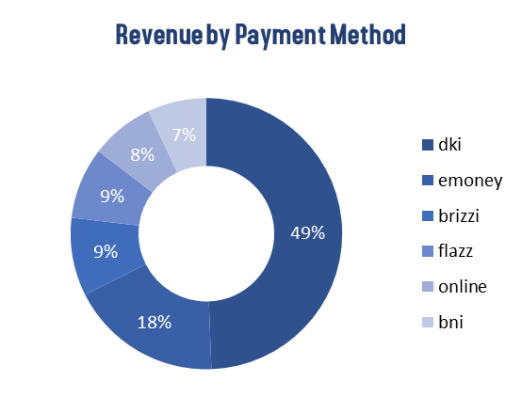
Revenue by Payment Method
Almost 50% of passengers use the Bank DKI (JakCard) ecosystem. This correlates strongly with Subsidy Recipients & Government Programs (Elderly, Students, Civil Servants).
If combined, commercial banks (Mandiri, BRI, BCA, BNI) control about 43% of the share
Interestingly, the adoption of digital systems is growing but not yet dominant. This indicates that passengers are still more comfortable with 'Physical Card Tapping,' which is perceived as faster than having to access their phones first.
Insight:
To increase Revenue (not just passenger count), marketing focus must be directed at the 43% commercial bank users.
There is huge untapped potential in Bank BCA, the largest retail transactional bank in Jakarta, to convert its users to bus riders.

Slide 9
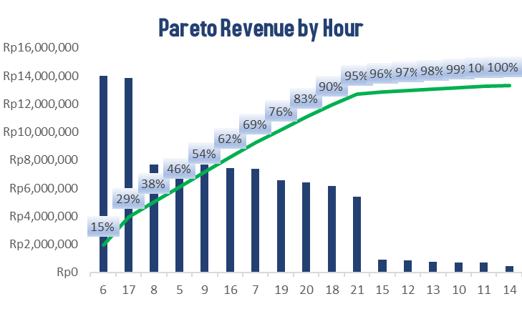
The Golden 5 Hours
In just 5 Operational Hours (05:00-09:00 & 17:00), Transjakarta secures more than 50% of Daily Revenue.
06:00 AM and 05:00 PM are the peak times, contributing nearly 30% of total revenue. Surprisingly, 05:00 AM generates more revenue than 07:00 AM.
Insight:
Deploy premium fleets at 05:00-06:00 AM due to its high revenue contribution.
Reduce frequency (loosen headway) during 10:00 - 14:00 to save fuel and costs, as the impact on lost revenue is minimal.

Slide 10
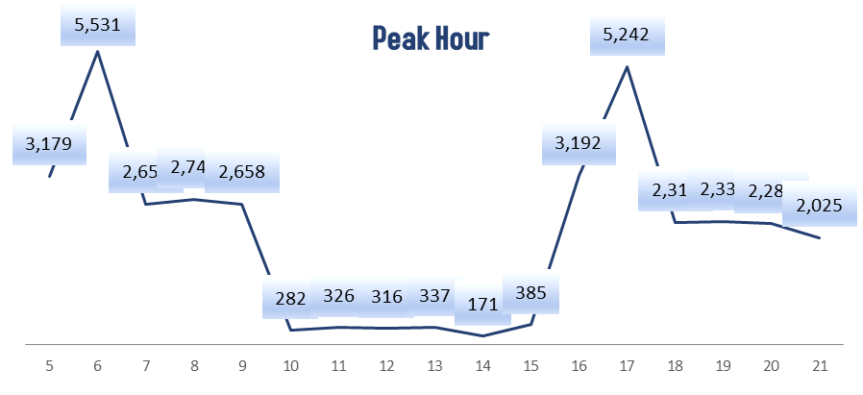
Peak Hour
Transjakarta passengers are primarily "Long-Distance Commuters." They must depart very early (5-6 AM) from satellite cities (Bekasi, Depok, Tangerang) to reach Jakarta's central offices by 8 AM. Passengers traveling between 7-8 AM represent the "second wave" who live closer to the city center.
A rapid surge occurs starting from 15:00 (385 passengers), exploding to a peak at 17:00 (5,242 passengers).
An extreme drop in traffic occurs during mid-day hours (10:00 AM – 2:00 PM), with an average of only 200-300 passengers.
Insight:
Apply Shift Schedules. Operate 100% fleet at 05:00-09:00, then pull 70% of the fleet to the pool at 10:00-14:00 for maintenance/rest.

Slide 11
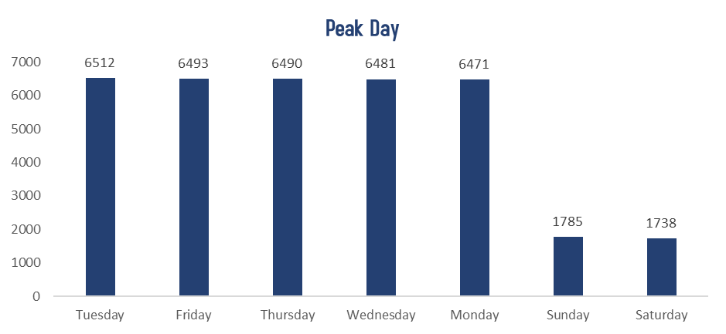
Peak Day
There is almost 0% variance from Monday to Friday. Passengers are the same people with the same routine every workday.
When offices close, Transjakarta loses 3/4 of its customers. This proves it is not yet a top choice for leisure/tourism.
Sunday traffic is slightly higher than Saturday, likely due to Car Free Day (CFD) or social events.
Insight:
Drastically cut fleet operations on weekends (73% traffic drop) to prevent losses.
Create a "Cheap Jakarta Tour" campaign specifically for weekends to boost ridership.

Slide 12
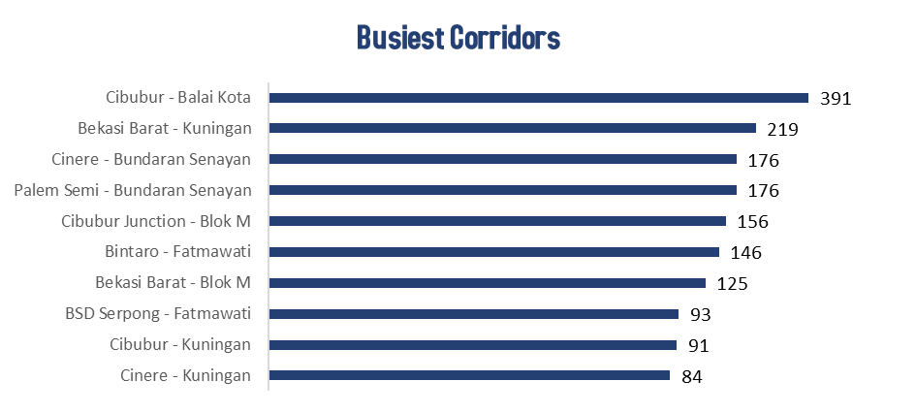
Busiest Corridors
Cibubur - Balai Kota is the busiest because KRL (train) access is not as convenient there compared to Bekasi/Serpong. They are highly dependent on Transjakarta.
The Top 10 routes confirm that Transjakarta is the backbone not just for DKI Jakarta, but for Bodetabek (Greater Jakarta) citizens.
Insight:
Maintain "Direct Service" routes during peak hours. Do not force passengers to transit at central hubs (like Cawang/Harmoni) as it increases travel time.
Passengers from BSD, Bintaro, and Cibubur are upper-middle class car owners. Ensure Park & Ride facilities at starting points are expanded and safe. If parking is difficult, they will revert to using private cars.

Slide 13
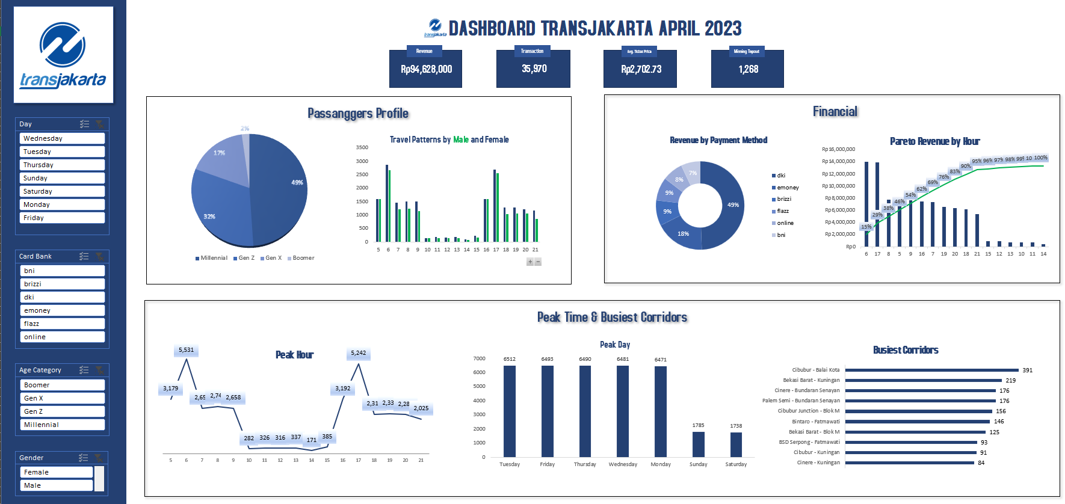

Slide 14
Irfan Maulana
Data Analyst – Final Project Ms. Excel DQLab
Follow me:
Instagram: @i.ipaang
LinkedIn: https://www.linkedin.com/in/maulana-irfan/
Github: https://github.com/fafnir96

